Slide 1
FMSE lecture 07
Predicate Logic part II and set theory

Slide 2
Outline
Free and bound variables in quantifiers
Replacing free variables
Scope of quantifiers
Mixing quantifiers
Order of quantifiers
Mathematical data types (Sets)
Popular sets
Power set
Cartesian product and relations
Domain of a set
Range of set

Slide 3
3. Free and bound variables contd..
Predicate expressions, which are generally of the form P(t1, t2,...,tn), have the symbol P as a node, but now P has n many subtrees, namely the parse trees of the terms t1, t2,...,tn.
You can see that variables occur at two different sorts of places.
First, they appear next to quantifiers ∀ and ∃ in nodes like ∀x and ∃z;
Such nodes always have one subtree, subsuming their scope to which the respective quantifier applies.

Slide 4
3. Free and bound variables contd..
The other sort of occurrence of variables is leaf nodes containing variables.
If variables are leaf nodes, then they stand for values that still have to be made concrete.
There are two principal such occurrences:
We have three leaf nodes x. If we walk up the tree beginning at any one of these x leaves, we run into the quantifier ∀x.
This means that those occurrences of x are actually bound to ∀x so they represent, or stand for, any possible value of x.

Slide 5
3. Free and bound variables contd..
In walking upwards, the only quantifier that the leaf node y runs into is ∀x but that x has nothing to do with y;
x and y are different place holders.
So y is free in this formula.
This means that its value has to be specified by some additional information,
for example
the contents of a location in memory

Slide 6
Definition 2.6
Let φ be a formula in predicate logic. An occurrence of x in φ is free in φ if it is a leaf node in the parse tree of φ such that there is no path upwards from that node x to a node ∀x or ∃x. Otherwise, that occurrence of x is called bound.
For ∀x φ, or ∃x φ, we say that φ – minus any of φ’s sub formulas ∃x ψ, or ∀x ψ – is the scope of ∀x, respectively ∃x.
Thus, if x occurs in φ, then it is bound if, and only if, it is in the scope of some ∃x or some ∀x; otherwise it is free.
In terms of parse trees, the scope of a quantifier is just its subtree, minus any subtrees which re-introduce .

Slide 7
3. Free and bound variables contd..
quantifier for x; e.g. the scope of ∀x in ∀x (P(x) → ∃x Q(x)) is P(x).
It is quite possible, and common, that a variable is bound and free in a formula.
Consider the formula
(∀x (P(x) ∧ Q(x))) → (¬P(x) ∨ Q(y))

Slide 8
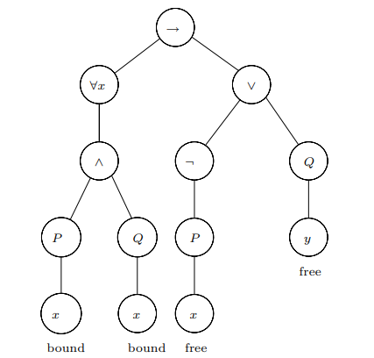
(∀x (P(x) ∧ Q(x))) → (¬P(x) ∨ Q(y))

Slide 9
3. Free and bound variables contd..
Note, however, that a single leaf either is under the scope of a quantifier, or it isn’t.
Hence individual occurrences of variables are either free or bound, never both at the same time.

Slide 10
4. SUBSTIUTION
Variables are place holders so we must have some means of replacing them with more concrete information.
On the syntactic side, we often need to replace a leaf node x by the parse tree of an entire term t.
Recall from the definition of formulas that any replacement of x may only be a term.
it could not be a predicate expression, or a more complex formula, for x serves as a term to a predicate symbol one step higher up in the parse tree.

Slide 11
4. SUBSTIUTION CONTD..
In substituting t for x we have to leave untouched the bound leaves x since they are in the scope of some ∃x or ∀x, i.e. they stand for some unspecified or all values respectively.
Definition 2.7: Given a variable x, a term t and a formula φ we define φ[t/x] to be the formula obtained by replacing each free occurrence of variable x in φ with t.
For example
Let f be a function symbol with two arguments and φ the formula with the parse tree in Figure 2.1

Slide 12
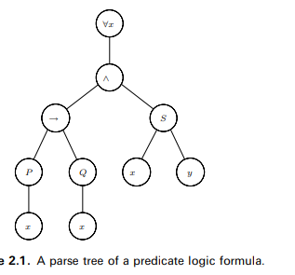
∀x ((P(x) → Q(x)) ∧ S(x, y)).

Slide 13
(∀x (P(x) ∧ Q(x))) → (¬P(x) ∨ Q(y))
Figure 2.2

Slide 14
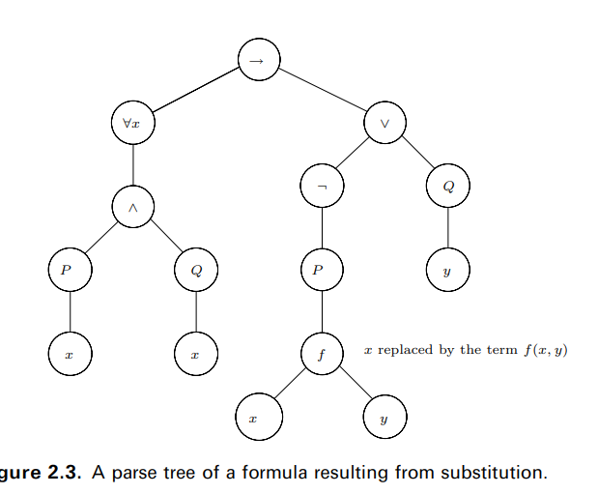
4. SUBSTIUTION CONTD..

Slide 15
4. SUBSTIUTION CONTD..
substitutions can give rise to undesired side effects.
In performing a substitution φ[t/x], the term t may contain a variable y, where free occurrences of x in φ are under the scope of ∃y or ∀y in φ.
By carrying out this substitution φ[t/x], the value y, which might have been fixed by a concrete context, gets caught in the scope of ∃y or ∀y.
This binding capture overrides the context specification of the concrete value of y, for it will now stand for ‘some unspecified’ or ‘all ,’ respectively.
Such undesired variable captures are to be avoided at all costs

Slide 16
Definition 2.8 substitution contd..
Given a term t, a variable x and a formula φ, we say that t is free for x in φ if no free x leaf in φ occurs in the scope of ∀y or ∃y for any variable y occurring in t.
For example
Given the parse tree of φ and the parse tree of t, we can perform the substitution [t/x] on φ to obtain the formula φ[t/x].
The latter has a parse tree where all free x leaves of the parse tree of φ are replaced by the parse tree of t.
What ‘t is free for x in φ’ means is that the variable leaves of the parse tree of t won’t become bound if placed into the bigger parse tree of φ[t/x].

Slide 17
4. SUBSTIUTION CONTD..
For example, if we consider x, t and φ in Figure 2.3, then t is free for x in φ since the new leaf variables x and y of t are not under the scope of any quantifiers involving x or y.

Slide 18
(∀x (P(x) ∧ Q(x))) → (¬P(x) ∨ Q(y))
Figure 2.2

Slide 19
Example
Consider the φ with parse tree in Figure 2.4
and let t be f(y, y).
All two occurrences of x in φ are free.
The leftmost occurrence of x could be substituted since it is not in the scope of any quantifier, but substituting the rightmost x leaf introduces a new variable y in t which becomes bound by ∀y. Therefore, f(y, y) is not free for x in φ

Slide 20
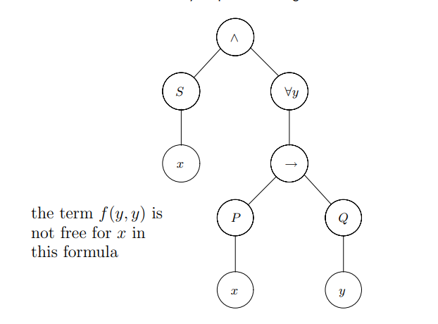
Figure 2.4

Slide 21
Mixing Quantifiers
“Every even integer greater than 2 is the sum of two primes.”
For every even integer n greater than 2, there exist primes p and q such that n = p + q.
Let Evens be the set of even integers greater than 2, and let Primes be the set of primes.
∀n ∈ Evens ∃p ∈ Primes ∃q ∈ Primes. n = p + q.
Evens={4,6,8,10,12…..}
Primes={2,3,5,7,11,13,17,19}
N=4, 2+2 true,
6=3+3,true

Slide 22
Order of Quantifiers contd..
There is some number n which is greater than any number m
n= {0,1,2,3…..}, m={0,1,2,3…..}
n=10,
m<n
0<10 true
1<10 true
2<10 true
;;;;;;;;;
10<10 false →

Slide 23

Scope of quantifiers
The scope of this quantification is the predicate .
All occurrences of the variable n within this predicate are said to be bound by that quantification.
m in the quantification remains free.

Slide 24
Scope of quantifiers contd..
What about this example? Which variable is bound and which variable is free?
Draw it parse tree and find the free variables as well as bound variables
w=-1
m={01,2,3….}, n={0,1,2,3…..} 0<6→ o<-1 →0>m
0<6hypothesis true
0<-1 conclusion false
Implication is false

Slide 25
Substitution for free variables
An expression can be substituted for a free variable.
This is written as P[E/x] x is replaced by P pronounced as P with E for x.
For example
In the predicate x CHESS => x GO
The substitution of the expression alice for the x variable, results in alice CHESS => alice GO

Slide 26
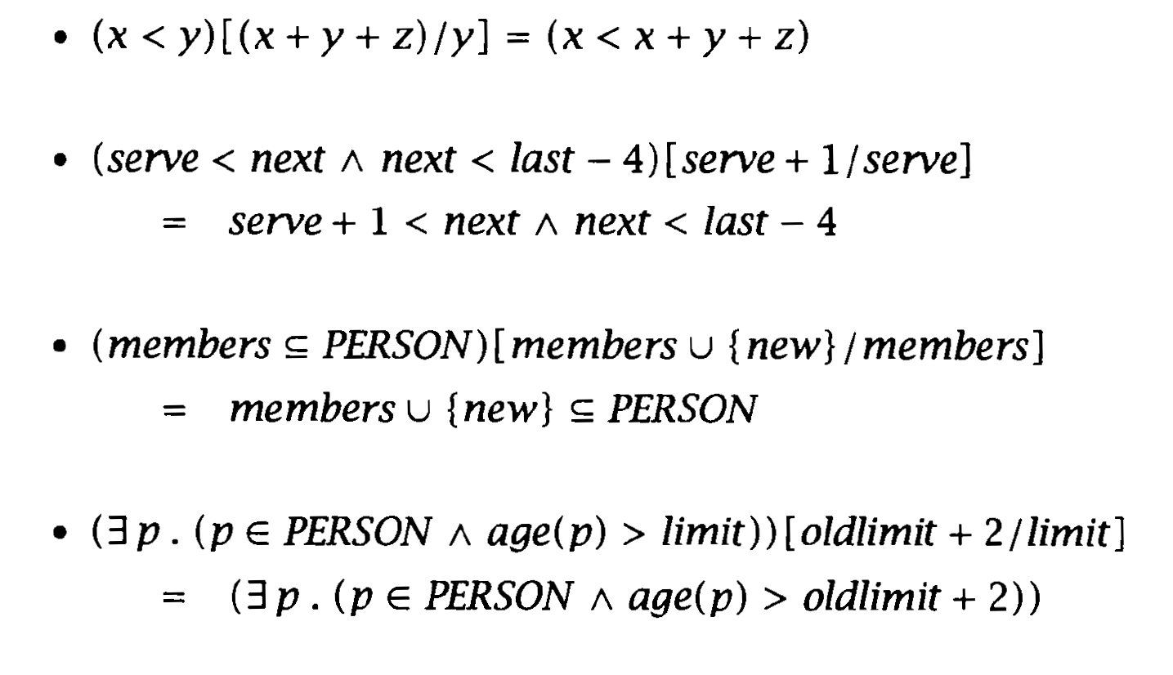
Substitution for free variables contd..
More complex expressions can be substituted for variables.
For example

Slide 27
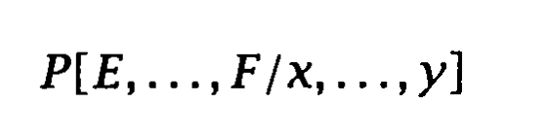
Substitution for free variables contd..
Bound variables are not substituted.
We can rename bound variables.
Collection of variables can be substituted as
Where the list of variables x……y are variables to be substituted
E……..F the expressions to replace them

Slide 28
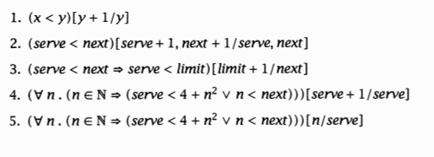
What are the results of applying the following substitutions?
(x<y) [y+1/y]➔ (x<y+1) if ⱯxⱯy.(N={0,1,2,3……} .x<=y) is always true
If x=0, y=0
0<0+1 true
If x=2, y=1
2<1+1 false
Limit <=50, serve =49,next=50,
Serve<limit+1==>serve<limit
1<51➔1<50 False
49<51→49<50
Ɐn.(n n={0,1,2,3….}, serve=10, next 25
n=0, 10+1<4+ 0 true
n=1, 11<4+1V 1<25 true
n=5 11<4+25 V 5<25
N=25 11<4+625 V25<25
Ɐn.(n

Slide 29
Mathematical Data Types

Slide 30
Sets
Set is a bunch of objects, which are called the elements.
Order of elements is not significant.
For example, here are some sets:
A = {Alex, Tippy, Shells, Shadow} dead pets
B = {red, blue, yellow} primary colors
C = {{a,b} , {a,c} , {b,c}} a set of sets

Slide 31
Sets contd..
The expression e ∈ S asserts that e is an element of set S
For example
blue ∈ B

Slide 32
Some popular sets
Mathematicians have devised special symbols to represent some common sets.
symbol set elements
∅ the empty set none
Nat (N) nonnegative integers {0, 1, 2, 3,...}
Nat₁ ^{(N1)} integers greater than 0 { 1, 2, 3,...}
Z integers {...,⁻3,⁻2,⁻1, 0, 1, 2, 3,...}
Q rational numbers ¹² , ⁻⁵³ , 16, etc.
R real numbers π, e, ⁻9, √2, etc.
C complex numbers i, ² , √2 ⁻ 2i, etc.

Slide 33
Comparing and combining sets
The expression S ⊆ T indicates that set S is a subset of set T (it could be said that S = T) true
T={1,3,5,7,9,11}
S={1,9} S ⊆ T ,S=T
can we also say T=S
N ⊆ Z and Q ⊆ R (every rational number is a real number .
There are two ways to combine sets
Union of sets
Intersection of sets
Example
Let
X ::= {1, 2, 3}
Y ::= {2, 3, 4}

Slide 34
Comparing and combining sets
Unión of X and Y is :
X ∪ Y = {1, 2, 3, 4}.
Intersection of X and Y is:
X ∩ Y = {2, 3}.

Slide 35
Complement of Set
for any subset, A, we define A bar to be the set of all elements not in A
For example
Positive real numbers is the set of negative real numbers together with zero
R+(bar) ^{= R(bar)} ∪{⁰} .
Let A and B are disjoint sets A ∩ B = ∅
then we can write set A as :A is a subset of the complement of B.

Slide 36
Power Set
The set of all the subsets of a set,
^{P}(A), of A.
So B ^{∈P}(A) Iff B ⊆ A.
^{P}({1, 2}) are ∅, {1} , {2} and {1, 2}.

Slide 37
Set Builder Notation
An important use of predicates is in set builder notation.
A ::= {n ∈ N | n is a prime and n =4k +1 for some integer k}
The set A consists of all nonnegative integers n for which the predicate “n is a prime and n =4k +1 for some integer k” is true. Thus, the smallest elements of A are: 5, 13, 17, 29, 37, 41, 53, 57, 61, 73,....
B ::= {x ∈ R | x³ ⁻ 3x +1 > 0 }

Slide 38
Proving Set Equalities
X = Y means that z ∈ X if and only if z ∈ Y , for all elements, z.
For example
A ∩ (B ∪ C)=(A ∩ B) ∪ (A ∩ C)

Slide 39
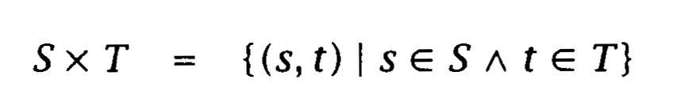
Relations
Machines/models can be required to maintain information about relationships on the information contained within them.
Relation between sets
If S and T are two sets, then their Cartesian product SxT is the set of all pairs (s, t) of elements from S and T respectively. This is defined as follows:

Slide 40
Relation notations
s↦t pronounced s maps to t
It exactly means the same as (s, t)ordered pair.
it is a pair whose first element is s and whose second element is t.
A relation R between sets S and T expresses a relationship between elements in S and elements in T.
It is captured as a set of pairs (s, t) with s S and t T representing those elements which are related.

Slide 41
Relation Example
PHOTOGRAPHER={anna, bob, chris, dave, elizabeth, francis} and
CAMERA={canon, kodak ,hasselblad ,minolta, olympus ,pentax}
The relation owns detailing the ownership relation between photographers and their cameras can be defined as follows
Owns={(anna, canon), (bob, canon), (bob, kodak), (chris, hasselblad), (chris, kodak), (chris, pentax), (dave, pentax), (elizabeth, pentax),(elizabeth, minolta)}

Slide 42
Relation Example contd..
Or using the notation map
Owns={(anna ↦ canon), (bob ↦ canon), (bob ↦ kodak), (chris ↦ hasselblad), (chris ↦ kodak), (chris ↦ pentax), (dave ↦ pentax), (elizabeth ↦ pentax),(elizabeth ↦ minolta)}
A relation between S and T is a subset of SxT or an element of P(SxT).
The notation S⟷T denotes the set of relations between S and T.

Slide 43
Relation Abbreviation
Hence S ⟷ T is an abbreviation for the set of all substes of SxT
S⟷T=P(SxT)// an element of power set of SxT
To specify that R is a relation between S and T we write RS⟷T.
In this case set S is said to be the source of R and the set T is said to be the target.
For example owns PHOTOGRAPHER⟷CAMERA
Read it as (Photographer owns camera)

Slide 44
Relation Abbreviation contd..
The statement that (dave, pentax) owns states that dave is related to pentax in the relation owns.
dave↦pentax also states that dave is related to pentax.
owns(dave↦pentax )
If owns records the cameras that are owned by the photographers, then this corresponds to the information that dave owns a pentax camera.

Slide 45
Relations use
When producing specifications, we are generally interested in extracting information from the relations our machines/models maintain,
To answer particular questions such as:

Slide 46
Relations use contd..
Owns={(anna, canon), (bob, canon), (bob, kodak), (chris, hasselblad), (chris, kodak), (chris, pentax), (dave, pentax), (elizabeth, pentax),(elizabeth, minolta)}
Does Bob own a camera?
How many cameras does Elizabeth own?
Who owns a Hasselblad camera?
Which cameras are used by both Chris and Dave?
How many cameras does Anna own?
Is there anyone that does not have a camera?
There are constructs for extracting the information required for questions to be expressed in relations.

Slide 47
Relations use contd..
Extracting the domain and range of a relation
Domain restriction: restricting the relation to a particular domain of interest
Range restriction: restricting the relation to a particular range of interest
Identifying the elements related to some item in a given set.
Relational inverse the relation the opposite way round

Slide 48
Domain of a Relation
The domain of a relation R S ↔T is the set of elements of S that R relates to something in T.
Items in the source set that are related to something, it is written dom(R)
Dom(owns)= {anna,bob, chris, dave, elizabeth}

Slide 49
Range of a Relation
The range is the set of elements of T that are related to some element of S. it is written ran(R)
For example
Ran(owns)={canon, kodak, hasselblad, minolta, pentax}

Slide 50
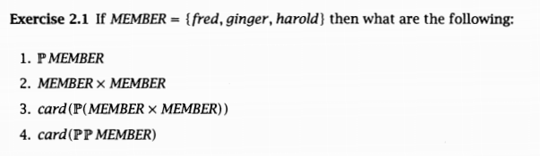
Solve
P(Member)={},{fred},{ginger},{harold},{fred,ginger},{fred,harold},{ginger,fred}{fred,ginger,harold} (2^n)
MemberxMember={fred,ginger},{fred,harold},{ginger,fred}{ginger,Harold},{Harold,fred},{Harold,ginger},{fred, fred},{ginger,ginger},{Harold,harold} nxn
CARD(MemberxMember)=9
CARD(P(MemberxMember))=2^9
CARD(P(P(MEMBER))=(2^³)
=(2^⁸)=

Slide 51
Categorizing Relations
●Collectively, there are few properties shared by all
relations.
●We often categorize relations into different types to study relations with particular properties.
●General outline for today:
●Find certain properties that hold of the relations we've seen so far.
●Categorize relations based on those properties.
●See what those properties entail.

Slide 52
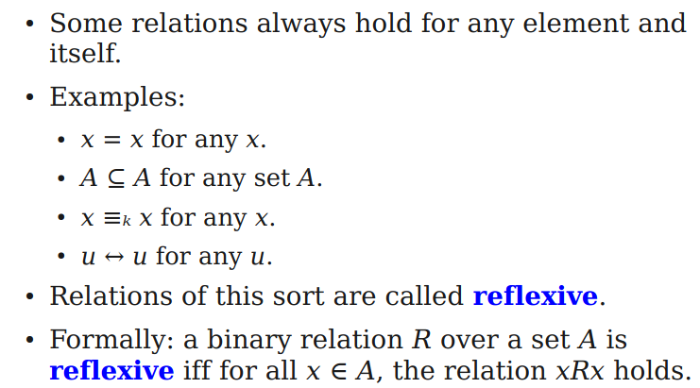
Reflexivity

Slide 53
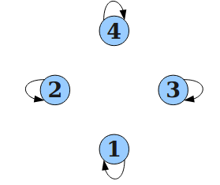
An Intuition for Reflexivity
the relation a = b over {1, 2, 3, 4}
For every x ∈ A, the relation xRx holds

Slide 54
Symmetry
●In some relations, the relative order of the objects doesn't matter.
●Examples:
●If x = y, then y = x.
●If u ↔ v, then v ↔ u.
●If x ≡ₖ y, then y ≡ₖ x.
●These relations are called symmetric.
●Formally: A binary relation R over a set A is called symmetric iff for all x, y ∈ A, if xRy, then yRx.

Slide 55
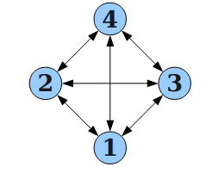
Symmetry
the relation a ≠ b over {1, 2, 3, 4}

Slide 56
Transitivity
●Many relations can be chained together.
●Examples:
●If x = y and y = z, then x = z.
●If u ↔ v and v ↔ w, then u ↔ w.
●These relations are called transitive.
●Formally: A binary relation R over a set A is called transitive iff for all x, y, z ∈ A, if xRy and yRz, then xRz.

Slide 57
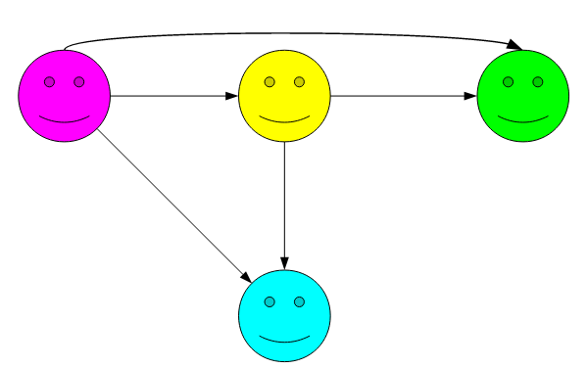
Transitivity

Slide 58
Equivalence Relations
●Some relations are reflexive, symmetric, and transitive:
●x = y
●u ↔ v
●Definition: An equivalence relation is a relation that is reflexive, symmetric and transitive.

Slide 59
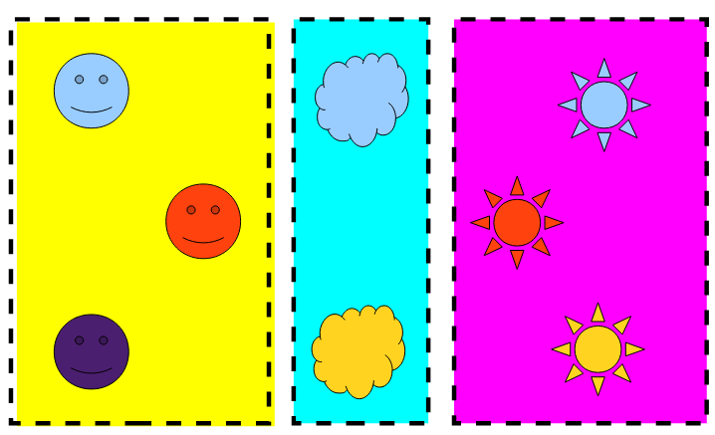
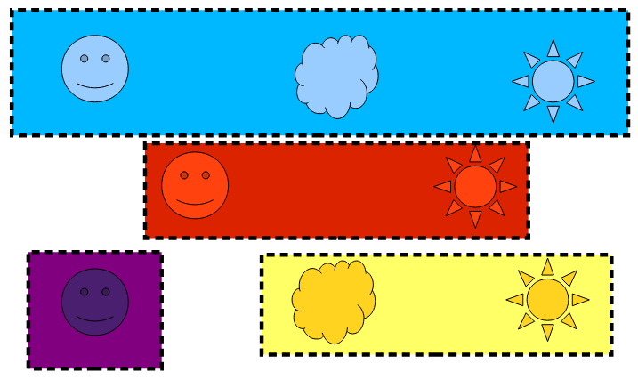
Equivalence Relations
xRy ≡ x and y have the same color.
xRy ≡ x and y have the same shape.

Slide 60
Equivalence Relations
●Some relations are reflexive, symmetric, and transitive:
●x = y
●u ↔ v
●Definition: An equivalence relation is a relation that is reflexive, symmetric and transitive.

Slide 61
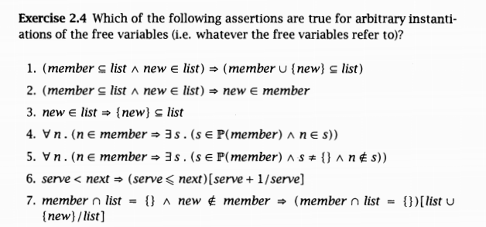
Solve contd…
P(Member)={},{fred},{ginger},{harold},{fred,ginger},{fred,harold},{ginger,fred}{fred,ginger,harold}

Slide 62
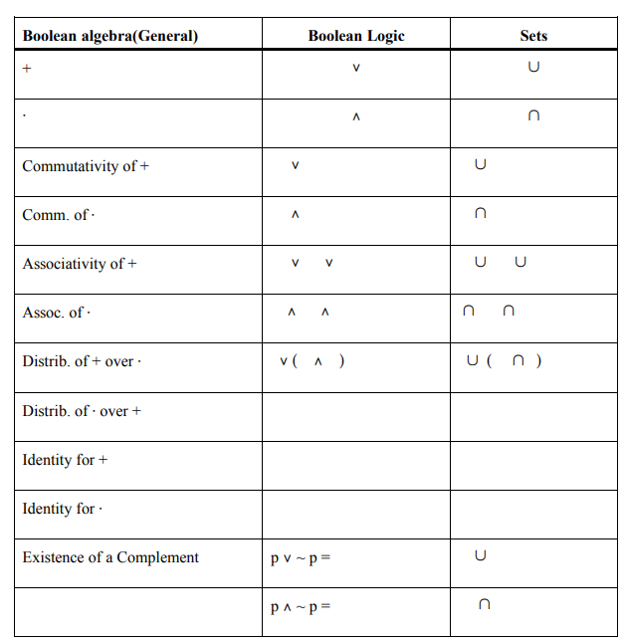

Slide 63
TO DO list
Read chapter 2 from the b- method an introduction Steve Schneider and solve its examples and exercises.
Read chapter 1 from logic in computer science, related to contents covered in lecture 4,5, 6 and 7 and solve relevant exercises.
Quiz will be held in next lecture.
Submit individual project proposal on real time systems. Assignments shall be covered from project.

Slide 64
Any questions?

